Slide 1

Predicting student math scores
Blanca T. Marmolejo

Slide 2


Agenda
Introduction
Target
Evaluation criteria
Model
Conclusion

Slide 3

Introduction
End of year state exams in Math, Reading and Writing are used to evaluate and rank schools.
Provide support for students early in the semester.
Improve end of year math test scores.
Boost school ranking to acquire more funding.

Slide 4
Target
Students
School
Tutoring services
Request increased funding based on examination of outcomes.
Leads to increased funding for public schools.
Offer hours at the school's learning center.
Provide extra sessions with teachers.
Recommend counseling services.
Suggest private tutoring options.
Increase parental involvement in some cases.
Support students' academic progress and success.
More government support programs due to improved evaluation.
Higher passing rates justify higher tuition fees for private institutions.
Highlight the positive impact on passing rates for students who regularly attend.
Benefit from school referrals for private tutoring services in the area.
School recognition and recommendation can attract more clients and generate revenue.

Slide 5

Evaluation criteria
Model
Parental factors
Student characteristics
Environmental factors
Classify potential student grades
≥70
<70

Slide 6
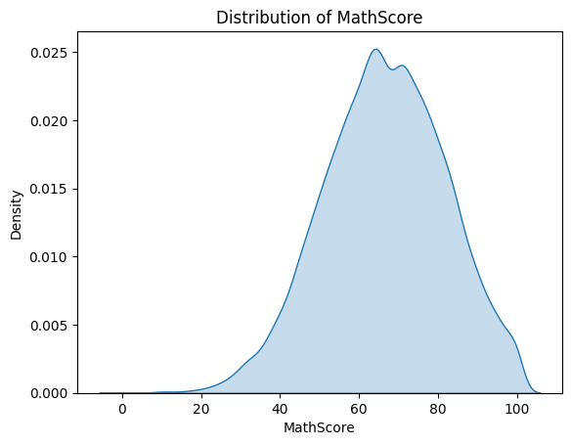
Evaluation criteria
Confirm target has normal distribution

Slide 7
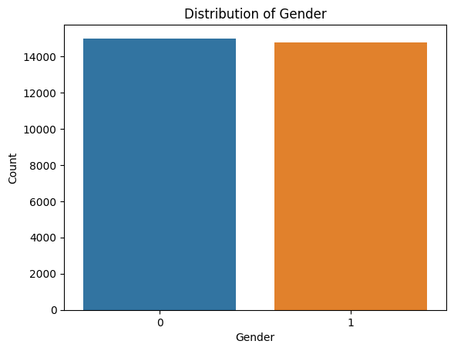
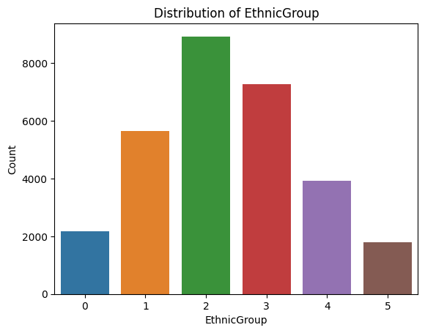
Evaluation criteria
Female : 0 Male : 1
Ethnic Group information was not specified.

Slide 8
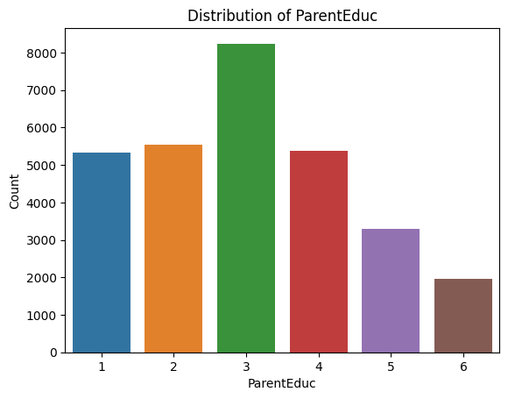
Evaluation criteria
some high school: 1
high school: 2
some college: 3
associate's degree: 4
bachelor's degree: 5
master's degree: 6
doctoral degree: 7

Slide 9
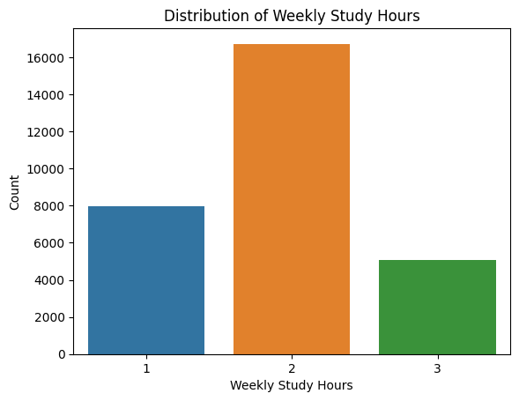
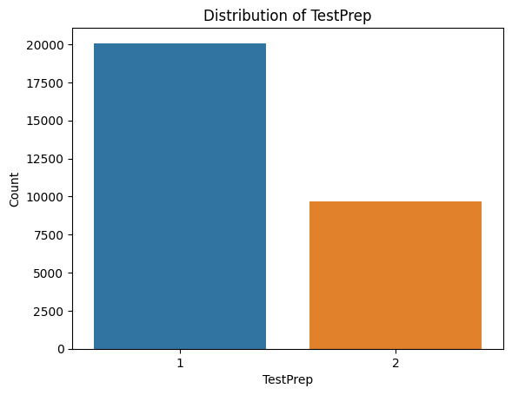
Evaluation criteria
Completed : 2 No Prep : 1
Less than 5 hours : 1, 5 to 10 hours : 2, More than 10 hours: 3

Slide 10
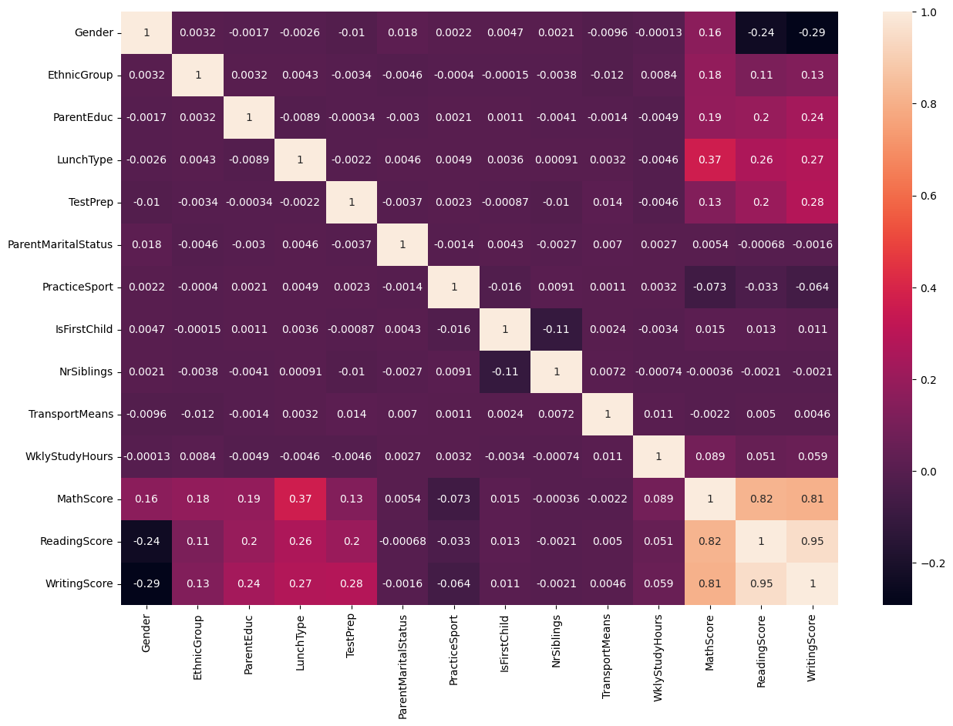
Evaluation criteria
No correlation for linear regression

Slide 11
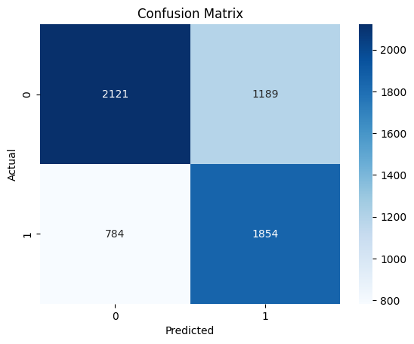
Model
Metric | Values
AUC Score | 0.743
Accuracy | 0.668
Precision | 0.609
Recall | 0.703

Slide 12

Conclusion
Pros
Cons
This model serves as an effective early detection device using personal information obtained at the beginning of the school year.
The results obtained can be used to closely monitor students throughout the year.
Class grades can be utilized to create additional models and predictions.
Combining quantitative and qualitative analysis enhances the accuracy of the predictions.
Challenges with personal information:
Inaccuracies due to omission or lies.
Concerns from parents and students about the use of personal information.
Sensitivity of ethnicity and gender:
Ethnicity and gender are sensitive topics.
Careful consideration needed when handling these aspects of personal information.
PREDICTING STUDENT MATH SCORES
12

Slide 13

Thank you
Blanca T. Marmolejo

